Slide 1

An Introduction to Elements of Intercultural Communication
Lille Catholic University
Summer Programme
June 2005
Grant Douglas

Slide 2
Greetings from Lille
Hi ! My name is Grant Douglas and I am the programme coordinator in Lille. I will also be teaching the class on intercultural communication.
I will soon be introducing myself at greater length on the marvellous forum that Madame B. has made available for us.
The following presentation is part of the course work for the intercultural communications class.
I expect you all to have read the presentation. It is divided into 4 parts with homework at the end of each part. The work in red is compulsory. The work in blue is optional but would be useful and fun.

Slide 3
Greetings from Lille
By doing some of the work now we will be able to have more meaningful discussions when you arrive.
It will also free up some time for you on the programme – ie. A little less time in class.
The work is self-correcting. You will not be graded on the quizzes.
We will also be moving some other work up-front to try and maximise the quality of the classroom time in Lille whilst also keeping the hours reasonable.
I look forward to interacting with you soon on the forum and then seeing you here in Lille.

Slide 4
Suggested schedule
I suggest you give yourselves 1 week for each part of the presentation and 1 week to exchange on the forum.
Part 1 – Introduction - to be finished by 29th March
Part 2 – Non-verbal commuication – to be finished by 12th April
Part 3 – Cultural values and dimensions, some theorists – to be finished by 26th April
Part 4 – Culture shock, getting ready to leave – to be finished by 10th May

Slide 5
Definitions of Culture
Goodenough said that « Culture is a set of beliefs or standards, shared by a group of people, which help the individuals to decide what is, what can be, how to feel, what to do and how to go about doing it. »
Ralph Linton :
« A culture is the configuration of learned behaviour and results of behaviour whose component elements are shared and transmitted by the members of a particular society. »

Slide 6
Milton Bennett has described culture as being :
« …the learned and shared values, beliefs and behaviours of a group of interacting people ».
Geert Hofstede sees culture as « the software of the mind ». It’s what programmes us to think, speak, act and feel the way we do.

Slide 7
Elements of Culture
Tylor described culture as a complex and interrelated set of elements comprising :
knowledge
beliefs and values
arts
laws
manners and morals
and all other kinds of skills and habits acquired by people as a member of a particular society.

Slide 8
Introducing Yourself :
Write down 5 things you would tell somebody if you were introducing yourself for the first time.
You have probably written down 5 things which we can consider as being « elements of culture »

Slide 9
Elements of Culture Include :
Language(s)
Nationality
Education (general)
Profession (specialised education)
Group (ethnicity)
Age
Religion
Family
Gender
Social class
Region
Corporate or organisational culture
And many others

Slide 10
Two important things to remember are :
Culture is learned !
Culture is forgotten - in the sense that we stop being conscious of its existence as learned behaviour - it comes naturally !

Slide 11
What is Intercultural Communication ?
Intercultural communication is the study of the process by which individuals who do not belong to the same culture try to exchange sets of meanings using different ways of thinking, feeling and behaving.
A French engineer working for an American company in Turkey using English to explain a new process to Chinese technicians.

Slide 12
Big C and Little c – The Iceberg Model of Culture

Slide 13
Different Aspects of Culture
Little c Culture
Patterns of beliefs, behaviours, values and norms
Attitudes
Cultural behaviour
Verbal communication
Non-verbal communication
Communication style
Subjective culture = the learned and shared values, beliefs and behaviours of a group of interacting people.
Types of subjective culture can include :
National - Japanese, Mexican etc.
Ethnic - pan-national, Arab, Gypsy, intra-national, Afro-American, European American etc
Regional - west and east coast Canada or USA
Gender - male and female
Social class - rich and poor
Education level
Religion
Age
Physical ability - disabled, blind, hearing
Organisational - university, multinational
Departmental - marketing, personnel, accounting etc.
Big C Culture
Music
Dance
Heroes and holidays
History
Economic system
Legal system
Cultural institutions
Linguistic systems (grammar etc.)
Objective culture = the artefacts and visions created by a group of interacting people, such as their political, legal and economic systems, expressions in art, architecture, literature and dance, heroes, holidays and collective history

Slide 14
Some basic assumptions about intercultural learning
The intercultural experience is complex, problematic and stressful.
Because we are largely unaware of our own cultural identities, we have great difficulty understanding the impact of culture on human relations.
People can change their behaviour and attitudes and grow in knowledge and skills.
Transitions are times of intense learning.
Intercultural learning does not try to eliminate culture shock.
Intercultural learning aims to lessen the shock and thereby potentially heighten the experience.
Intercultural learning aims to develop greater empathy and greater tolerance for ambiguity, self-awareness, flexibility and openness to learning in general.

Slide 15
Milton Bennett : Overcoming the Golden Rule - Sympathy and Empathy
The Golden Rule :
Treat other people the way you would like to be treated yourself.
The Lead Rule :
Treat other people the way they deserve to be treated.

Slide 16
Sympathy
The attempt to understand another person by imagining yourself in his or her POSITION.
The Golden rule and its communication strategy, sympathy, are based on the ASSUMPTION OF SIMILARITY.

Slide 17
The Platinum Rule
EMPATHY
The attempt to understand another person by imagining his or her perspective. The platinum rule and it’s communication strategy, empathy, is based on the ASSUMPTION OF DIFFERENCE.
Treat other people the way they want to be treated – or at least be aware of what that is.

Slide 18
Cultural Stereotypes
Milton Bennett :
A cultural stereotype is the application of a previously held generalization to every person in a cultural group; or generalizing from only a few people in a group. A stereotype is a rigid generalization, sometimes called « hardening of the categories ».

Slide 19
European Stereotypes – try and complete the table with European nationalities – use the same ones on each side.
Heaven is where :
The police are….
The cooks…..
The mechanics…..
The lovers…..
And it’s all organised by the…..
Hell is where :
The police are…..
The cooks…..
The mechanics…..
The lovers…..
And it’s all organised by the…..

Slide 20
European Stereotypes
Heaven is where :
The police are British
The cooks are French
The mechanics are German
The lovers are Italian
And it’s all organised by the Swiss
Hell is where :
The police are German
The cooks are British
The mechanics are French
The lovers are Swiss
And it’s all organised by the Italians

Slide 21
Cultural Generalizations
Milton Bennett :
Cultural generalization is the tendency of a majority of people in a cultural group to hold certain values and beliefs, and to engage in certain patterns of behaviours. It is a hypothesis based on RESEARCH about the preponderance of belief or the central tendency of a group of people.

Slide 22
Making the transition :
Stereotypes :
English people like fish and chips.
The French eat a lot of cheese.
The Germans are always on time.
Generalizations :
A lot of English people like fish and chips.
Many French people eat a lot of cheese.
German people tend to be on time.

Slide 23
Broadening the categories
It’s important to remain open and to be able to create and appreciate new categories :
English men who don’t like soccer
Canadians who don’t like hockey
Americans who don’t eat hamburgers
French people who don’t eat cheese
French people who don’t drink wine

Slide 24
A few ideas to remember :
Ethnocentrism – The idea that what is present in your own culture represents the natural and best way of doing things.
Cultural relativism – This suggests that cultures cannot be judged or evaluated from a single or absolute ethical or moral perspective. Evaluations are relative to the background from which they arise. No culture’s values, ethics or morals as a whole may be judged as inherently superior or inferior to another’s.

Slide 25
A few ideas to remember :
Cultural pluralism – A context in which more than one culture exists in a given society. Cultural pluralism is the social and political interaction within the same society of people with different ways of living and thinking. Ideally it implies the rejection of bigotry, bias and racism in favour of respect for the cultural traditions of other peoples.

Slide 26
Things aren’t always what they appear to be !
Look at the following slides and say what you can see. Do you all see the same things at the same times ? We’ll see !

Slide 27
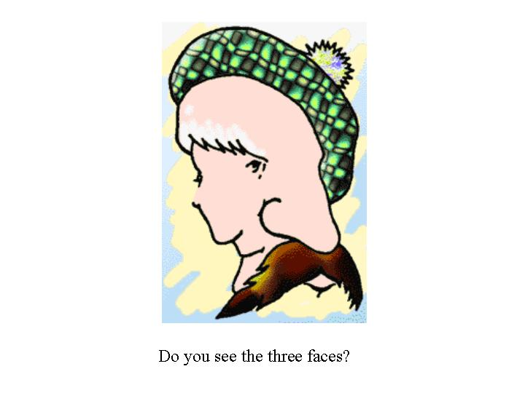

Slide 28
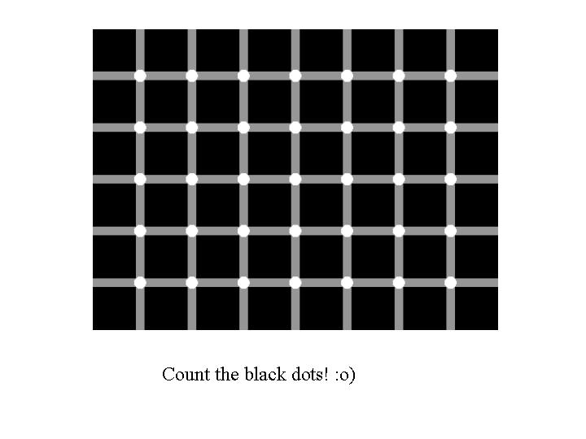

Slide 29
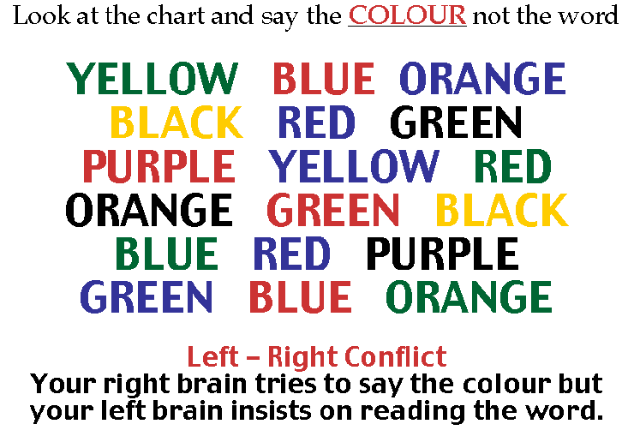

Slide 30
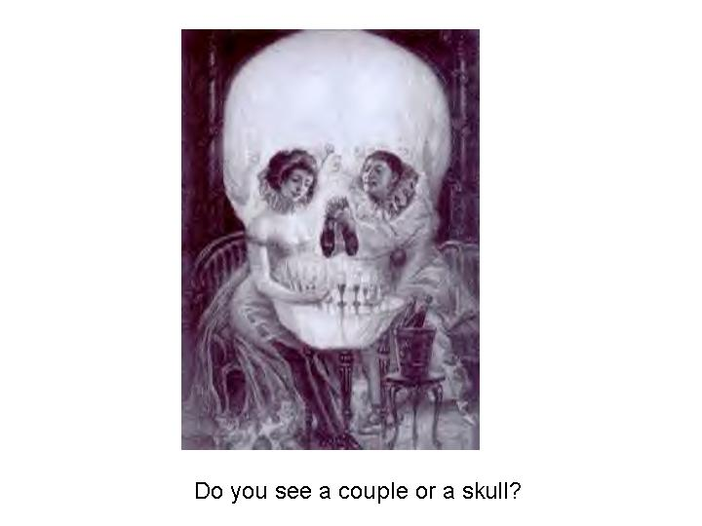

Slide 31
Over to you…
Part 1 – Introduction - to be finished by 29th March
Read the short texts on the following subjects and complete the corresponding quizzes/charts :
Introduce yourself-5 things (slide 8)
What is culture ?
What culture is not
Description or interpretation ?
Culture mapping – see separate instructions
I am – see separate instructions on the forum
Post your culture maps and any questions you have on the forum.

Slide 32
Non-Verbal Communication
You cannot NOT communicate !
What Edward T. Hall called « The Silent Language » in his book « The Hidden Dimension ».

Slide 33
Non-Verbal Communication
Communication is often divided into verbal and non-verbal. Although the figures differ it is generally accepted that non-verbal communication makes up the largest percentage of communication – between 75% - 90%.
Non-verbal communication can be difficult to comprehend as it is not universal (it changes from one culture to another) and it is multi-channel (it uses different channels simultaneously)

Slide 34
Elements of non-verbal communication
Paralanguage
The use of paralanguage to provide relationship cues –
superiority/inferiority,
sarcasm,
sincerity/deception

Slide 35
Elements of non-verbal communication
Body Language (Kinesics)
Gestures and posture
Dress – you cannot dress innocently !

Slide 36
Elements of non-verbal communication
Space Language (Proxemics)
Private, public and intimate space
Doors and desks – non-verbal boundaries

Slide 37
Elements of non-verbal communication
Eye Language (Occulistics)
Conversational pacing
Threats and propositions
Respect

Slide 38
Elements of non-verbal communication
Touch Language (Haptics)
Who can touch whom ?
Where ?
In what circumstance ?
Quivers and shakes – what happens when we break the rules ?

Slide 39
Elements of non-verbal communication
Olfactics
Acceptability or not of different odours
You are what you eat
People have very strong reactions to odours

Slide 40
E.T. Hall’s Model
Time – monochronic and polychronic
Space – intimate, private and public (proxemics)
Context – low context and high context

Slide 41
Monochronic or Polychronic ?
M Time
Time is a given constant.
People have to adjust around the constraints of time.
Time is quantifiable and limited.
People can do several things at once.
People generally do one thing at a time.
People generally finish one thing before moving on to another.
P Time
Time is not fixed or linear.
Time is an instrument for people to use.
There is always time and people are never too busy.
People can do several things at once.
It is not necessary to finish one thing before starting another.
You can do business with more than one person at a time.

Slide 42
E.T. Hall
A Question of Context ?
Low-Context Communication
"I" Identity
Autonomy,
Self/relational,
Privacy
Individual distinctiveness
Personal self-esteem
Emphasize self/other boundary
Sender-centred
Linear logic
Emphasize verbal communication
Direct, explicit verbal interaction
"Straight talk«
Goal-oriented
High-Context Communication
"We" Identity
Inclusion,
Group,
"Face"Ingroup harmony
Collective self-esteem
Emphasize ingroup/outgroup boundary
Interpreter-centred
Spiral logic
Emphasize non-verbal/contextual communication
Indirect, implicit verbal interaction
« Face talk »
Process-oriented

Slide 43
Over to you…
Part 2 – Non-verbal commuincation – to be finished by 12th April
Read the short texts on the following subjects and complete the corresponding quizzes/charts :
Non-verbal communication
Monochronic and polychronic
High context and low context
Direct and indirect communication
Try and think of non-verbal communication that is typical of your culture (gestures etc.). Think about where you are comfortable in a conversational situation (distance, volume etc.). Do you think this is the same everywhere ? What might be different in France ?
How are classrooms organised in your country ? Do your timetables ever change ?
Post your thoughts on the forum.

Slide 44
Understanding Cultures
Kluckhohn and Strodtbeck – 1961- Cultural values orientations
Trompenaars and Hampden-Turner – 1998 – « Riding the waves of Culture: Understanding cultural diversity in global business » - Cultural characteristics
Hofstede – 1997 – « Cultures and organizations: Software of the mind » - Dimensions of cultural values

Slide 45
Kluckhohn and Strodtbeck
The model is based on three primary assumptions:
1. There is a limited number of common human problems for which all peoples at all times must find some solution, including:
What is the character of innate human nature?
What is the relation of man to nature (and super-nature)?
What is the temporal focus of human life?
What is the modality of human activity?
What is the modality of humankind's relationship to other people?

Slide 46
Kluckhohn and Strodtbeck
2. While there is variability in solutions of all the problems, it is neither limitless nor random but is definitely variable within a range of possible solutions.
3. All alternatives of all solutions are present in all societies at all times but are differentially preferred.

Slide 47
Trompenaars
The Three Layers of Culture :
The outer layer : this is what people primarily associate with culture: the visual reality of behaviour, clothes, food, language, housing, etc.
This is the level of explicit culture.

Slide 48
Trompenaars
The Three Layers of Culture :
The middle layer : refers to the norms and values which a community holds: what is considered right and wrong (norms) or good and bad (values). Norms are often external and reinforced by social control. Values tend to be more internal than norms.
Values and norms structure the way people in a particular culture behave.
However, they are not visible, despite their influence on what happens at the observable surface.

Slide 49
Trompenaars
The Three Layers of Culture :
The inner layer : the deepest level of implicit culture. Understanding the core of the culture onion is the key to successfully working with other cultures.
The core consists of basic assumptions, series of rules and methods to deal with the regular problems that it faces.
These methods of problem-solving have become so basic that, like breathing, we no longer think about how we do it.
For an outsider these basic assumptions are very difficult to recognize.

Slide 50
Trompenaars
Every culture has developed its own set of basic assumptions.
These basic assumptions can be measured by dimensions.
Each dimension is like a continuum.
Cultures differ in how they deal with these dimensions, but they do not differ in needing to make some kind of response.

Slide 51
Trompenaars
Every culture distinguishes itself from others by the specific solutions it chooses to certain problems which reveal themselves as dilemmas. We can look at these problems under three headings:
those which arise from our relationships with other people;
those which come from the passage of time;
those which relate to the environment.
From the solutions different cultures have chosen to these universal problems, we can further identify seven fundamental dimensions of culture:

Slide 52
Trompenaars
The seven dimensions of culture
Universalism vs Particularism
What is more important - rules or relationships?
People in universalistic cultures share the belief that general rules, codes, values and standards take precedence over particular needs and claims of friends and relations.
In universalistic societies, the rules apply equally to the whole "universe" of members. Any exception weakens the rule.

Slide 53
Trompenaars
The seven dimensions of culture
Universalism vs Particularism
For example: the rule that you should bear truthful witness in a court of law, or give your honest judgment to the insurance company concerning a payment it is about to make to you, is more important here than particular ties of friendship or family.
It isn't that in universalistic cultures, particular ties are completely unimportant. But the universal truth, the law, is considered logically more significant than these relationships.

Slide 54
Trompenaars
The seven dimensions of culture
Universalism vs Particularism
Particularistic cultures see the ideal culture in terms of human friendship, extraordinary achievement and situations; and in intimate relationships. The "spirit of the law" is deemed more important than the "letter of the law".
Obviously there are rules and laws in particularistic cultures; but these merely codify here how people relate to each other. Rules are needed - if only to be able to make exceptions to them for particular cases - but we need to be able to count on our friends.

Slide 55
Trompenaars
The seven dimensions of culture
Individualism vs Communitarianism
Do we function in a group or as an individual?
In a predominantly individualistic culture people place the individual before the community. Individual happiness, fulfilment, and welfare set the pace.
People are expected to decide matters largely on their own and to take care primarily of themselves and their immediate family.
The community is judged by the extent to which it serves the interest of individual members.

Slide 56
Trompenaars
The seven dimensions of culture
Individualism vs Communitarianism
In a predominantly communitarian culture people place the community before the individual. It is the responsibility of the individual to act in ways which serve society. By doing so, individual needs will be taken care of naturally.
The quality of life for the individual is seen as directly dependent on the degree to which he takes care of his fellow man, even at the cost of individual freedom. The individual is judged by the extent to which he serves the interest of the community.

Slide 57
Trompenaars
The seven dimensions of culture
Specific vs Diffuse
How far do we get involved?
People from specific cultures start with the elements, the specifics. First they analyze them separately, and then they put them back together again. In specific cultures, the whole is the sum of its parts.
Each person's life is divided into many components: you can only enter one at a time. Interactions between people are highly purposeful and well-defined.

Slide 58
Trompenaars
The seven dimensions of culture
Specific vs Diffuse
The public sphere of specific individuals is much larger than their private sphere.
People are easily accepted into the public sphere, but it is very difficult to get into the private sphere, since each area in which two people encounter each other is considered separate from the other, a specific case.
Specific individuals concentrate on hard facts, standards, contracts.

Slide 59
Trompenaars
The seven dimensions of culture
Specific vs Diffuse
Diffusely oriented cultures start with the whole and see each element in perspective of the total. All elements are related to each other. These relationships are more important than each separate element; so the whole is more than just the sum of its elements.
Diffuse individuals have a large private sphere and a small public one.

Slide 60
Trompenaars
The seven dimensions of culture
Specific vs Diffuse
Newcomers are not easily accepted into either. But once they have been accepted, they are admitted into all layers of the individual's life. A friend is a friend in all respects: tennis, cooking, work, etc.
The various roles someone might play in your life are not separated. Qualities cherished by diffuse cultures include style, demeanor, ambiance, trust, understanding, etc.

Slide 61
Trompenaars
The seven dimensions of culture
Affective vs Neutral
Do we display our emotions?
In an affective culture people do not object to a display of emotions. It isn't considered necessary to hide feelings and to keep them inside.
Affective cultures may interpret the less explicit signals of a neutral culture as less important. They may be ignored or even go unnoticed.

Slide 62
Trompenaars
The seven dimensions of culture
Affective vs Neutral
In a neutral culture people are taught that it is incorrect to show one's feelings overtly. This doesn't mean they do not have feelings, it just means that the degree to which feeling may become manifest is limited. They accept and are aware of feelings, but are in control of them.
Neutral cultures may think the louder signals of an affective culture too excited, and over-emotional.
In neutral cultures, showing too much emotion may erode your power to interest people

Slide 63
Trompenaars
The seven dimensions of culture
Achievement vs Ascription
Do we have to prove ourselves to receive status or is it given to us?
Achieved status refers to what an individual does and has accomplished. In achievement-oriented cultures, individuals derive their status from what they have accomplished.
A person with achieved status has to prove what he is worth over and over again: status is accorded on the basis of his actions.

Slide 64
Trompenaars
The seven dimensions of culture
Achievement vs Ascription
Ascribed status refers to what a person is and how others relate to his or her position in the community, in society or in an organization.
In an ascriptive society, individuals derive their status from birth, age, gender or wealth.
A person with ascribed status does not have to achieve to retain his status: it is accorded to him on the basis of his being.

Slide 65
Trompenaars
The seven dimensions of culture
Time
Do we do things one at a time or several things at once?
Sequential vs Synchronic cultures
Every culture has developed its own response to time. The time orientation dimension has two aspects: the relative importance cultures give to the past, present, and future, and their approach to structuring time.

Slide 66
Trompenaars
The seven dimensions of culture
Time
Sequential vs Synchronic cultures
Time can be structured in two ways.
In one approach time moves forward, second by second, minute by minute, hour by hour in a straight line. This is called sequentialism.
In another approach time moves round in cycles: of minutes, hours, days, years. We call this synchronism.

Slide 67
Trompenaars
The seven dimensions of culture
Time
People structuring time sequentially tend to do one thing at a time. They view time as a narrow line of distinct, consecutive segments. Sequential people view time as tangible and divisible. They strongly prefer planning and keeping to plans once they have been made. Time commitments are taken seriously. Staying on schedule is a must.

Slide 68
Trompenaars
The seven dimensions of culture
Time
People structuring time synchronically usually do several things at a time. To them, time is a wide ribbon, allowing many things to take place simultaneously.
Time is flexible and intangible. Time commitments are desirable rather than absolute.
Plans are easily changed. Synchronic people especially value the satisfactory completion of interactions with others.

Slide 69
Trompenaars
The seven dimensions of culture
Time
Past-oriented cultures : If a culture is predominantly oriented towards the past, the future is seen as a repetition of past experiences. Respect for ancestors and collective historical experiences are characteristic of a past-oriented culture.

Slide 70
Trompenaars
The seven dimensions of culture
Time
Present-oriented cultures : A predominantly present-oriented culture will not attach much value to common past experiences nor to future prospects. Day-by-day experiences tend to direct people's life.

Slide 71
Trompenaars
The seven dimensions of culture
Time
Future-oriented cultures : In a future-oriented culture most human activities are directed toward future prospects. Generally, the past is not considered to be vitally significant to a future state of affairs. Planning constitutes a major activity in future-oriented cultures.

Slide 72
Trompenaars
The seven dimensions of culture
Internal vs External
Do we control our environment or work with it ?
Relations with Nature. Every culture has developed an attitude towards the natural environment. Survival has meant acting with or against nature. The way we relate to our environment is linked to the way we seek to have control over our own lives and over our destiny or fate.

Slide 73
Trompenaars
The seven dimensions of culture
Internal vs External
Internalistic people have a mechanistic view of nature. They see nature as a complex machine and machines can be controlled if you have the right expertise.
Internalistic people do not believe in luck or predestination. They are 'inner-directed' - one's personal resolution is the starting point for every action. You can live the life you want to live if you take advantage of the opportunities.
Man can dominate nature - if he makes the effort.

Slide 74
Trompenaars
The seven dimensions of culture
Internal vs External
Externalistic people have a more organic view of nature. Mankind is one of nature's forces, so should operate in harmony with the environment. Man should subjugate to nature and go along with its forces.
Externalistic people do not believe that they can shape their own destiny. 'Nature moves in mysterious ways', and therefore you never know what will happen to you.
The actions of externalistic people are 'outer-directed' - adapted to external circumstances.

Slide 75
Trompenaars
Reconciliation Method
How do we, or should we, better accommodate the differences between our cultures and others with whom we are trying to work, do business or manage ?

Slide 76
Trompenaars
Reconciliation Method
In dealing with different cultures, you have several options:
Ignoring other cultures : One type of response is to ignore the other orientation. You are sticking to your own cultural standpoint. Your style of decision making is to either impose your own way of doing things because it is your belief that your way of doing things and your values are best, or because you have rejected other ways of thinking or doing things because you have either not recognised them or have no respect for them.

Slide 77
Trompenaars
Reconciliation Method
In dealing with different cultures, you have several options:
Abandon your standpoint : Another response is to abandon your orientation and 'go native'. Here you adopt a 'when in Rome, do as Roman's do' approach. Acting or keeping up such pretences won't go unseen - you will be very much an amateur. Other cultures will mistrust you - and you won't be able offer your own strengths to the marriage.

Slide 78
Trompenaars
Reconciliation Method
In dealing with different cultures, you have several options:
Compromise : Sometimes do it your way. Sometimes give in to the others. But this is a win-lose solution or even lose-lose solution. Compromise cannot lead to a solution in which both parties are satisfied - something has to give.

Slide 79
Trompenaars
Reconciliation Method
In dealing with different cultures, you have several options:
Reconciliation : What is needed is an approach where the two opposing views can come to fuse or blend - where the strength of one extreme is extended by considering and accommodating the other. This is reconciliation.

Slide 80
Trompenaars
Reconciliation Method
In summary you should learn to:
Recognise cultural differences
Respect cultural differences
Reconcile cultural differences

Slide 81
Geert Hofstede
" Culture is more often a source of conflict than of synergy. Cultural differences are a nuisance at best and often a disaster."
Prof. Geert Hofstede, Emeritus Professor, Maastricht University.

Slide 82
Hofstede
Prof. Geert Hofstede conducted perhaps the most comprehensive study of how values in the workplace are influenced by culture.
From 1967 to 1973, while working at IBM as a psychologist, he collected and analyzed data from over 100,000 individuals from 50 countries and 3 regions.

Slide 83
Hofstede
Subsequent studies validating the earlier results have included commercial airline pilots and students in 23 countries, civil service managers in 14 counties, 'up-market' consumers in 15 countries and 'elites' in 19 countries.

Slide 84
Hofstede
From the initial results, and later additions, Hofstede developed a model that identifies four primary Dimensions to assist in differentiating cultures: Power Distance - PDI, Individualism - IDV, Masculinity - MAS, and Uncertainty Avoidance - UAI.

Slide 85
Hofstede
Geert Hofstede added a fifth Dimension after conducting an additional international study with a survey instrument developed with Chinese employees and managers.
That Dimension, based on Confucian dynamism, is Long-Term Orientation - LTO and was applied to 23 countries.
Although Hofstede has been criticised for his methodology (initially using people from only one company), most people accept the validity of his results.

Slide 86
Hofstede
Power Distance Index (PDI)
Focuses on the degree of equality, or inequality, between people in the country's society.
A High Power Distance ranking indicates that inequalities of power and wealth have been allowed to grow within the society.
These societies are more likely to follow a caste system that does not allow significant upward mobility of its citizens.

Slide 87
Hofstede
Power Distance Index (PDI)
A Low Power Distance ranking indicates the society de-emphasizes the differences between citizen's power and wealth.
In these societies equality and opportunity for everyone is stressed.

Slide 88
Hofstede
Individualism (IDV)
Focuses on the degree the society reinforces individual or collective achievement and interpersonal relationships.
A High Individualism ranking indicates that individuality and individual rights are paramount within the society.
Individuals in these societies may tend to form a larger number of looser relationships.

Slide 89
Hofstede
Individualism (IDV)
A Low Individualism ranking typifies societies of a more collectivist nature with close ties between individuals.
These cultures reinforce extended families and collectives where everyone takes responsibility for fellow members of their group.

Slide 90
Hofstede
Masculinity (MAS)
Focuses on the degree the society reinforces, or does not reinforce, the traditional masculine work role model of male achievement, control, and power.
A High Masculinity ranking indicates the country experiences a high degree of gender differentiation.
In these cultures, males dominate a significant portion of the society and power structure, with females being controlled by male domination.

Slide 91
Hofstede
Masculinity (MAS)
A Low Masculinity ranking indicates the country has a low level of differentiation and discrimination between genders.
In these cultures, females are treated equally to males in all aspects of the society.

Slide 92
Hofstede
Uncertainty Avoidance Index (UAI)
Focuses on the level of tolerance for uncertainty and ambiguity within the society - i.e. unstructured situations.
A High Uncertainty Avoidance ranking indicates the country has a low tolerance for uncertainty and ambiguity.
This creates a rule-oriented society that institutes laws, rules, regulations, and controls in order to reduce the amount of uncertainty.

Slide 93
Hofstede
Uncertainty Avoidance Index (UAI)
A Low Uncertainty Avoidance ranking indicates the country has less concern about ambiguity and uncertainty and has more tolerance for a variety of opinions.
This is reflected in a society that is less rule-oriented, more readily accepts change, and takes more and greater risks.

Slide 94
Hofstede
Long-Term Orientation (LTO)
Focuses on the degree the society embraces, or does not embrace, long-term devotion to traditional, forward thinking values.
High Long-Term Orientation ranking indicates the country prescribes to the values of long-term commitments and respect for tradition.
This is thought to support a strong work ethic where long-term rewards are expected as a result of today's hard work.
However, business may take longer to develop in this society, particularly for an "outsider".

Slide 95
Hofstede
Long-Term Orientation (LTO)
A Low Long-Term Orientation ranking indicates the country does not reinforce the concept of long-term, traditional orientation.
In this culture, change can occur more rapidly as long-term traditions and commitments do not become impediments to change.

Slide 96
Web Resources
Kluckhohn : www.valuescenter.org/
Trompenaars : www.7d-culture.nl/index1.html
Hofstede : www.geert-hofstede.com/
http://www.geert-hofstede.com/hofstede_united_states.shtml
http://www.geert-hofstede.com/hofstede_canada.shtml
http://www.geert-hofstede.com/hofstede_france.shtml

Slide 97
Changing Perspectives…
What can you see on the next slides ?

Slide 98
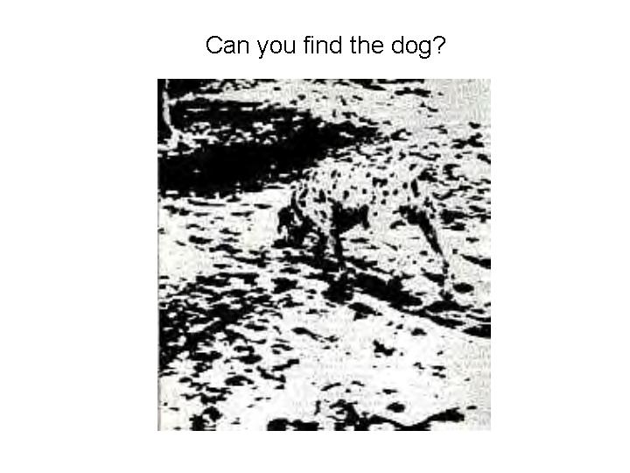

Slide 99
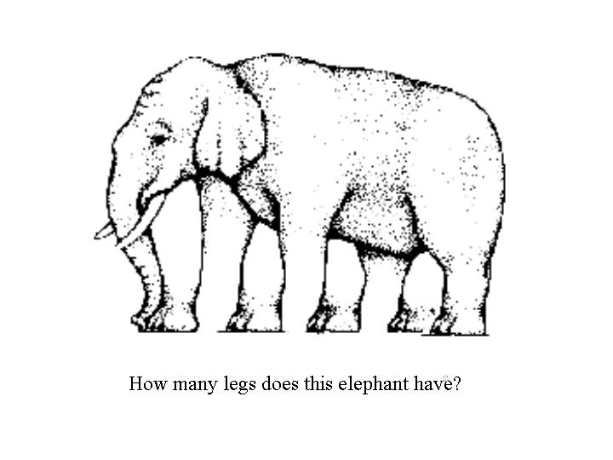

Slide 100
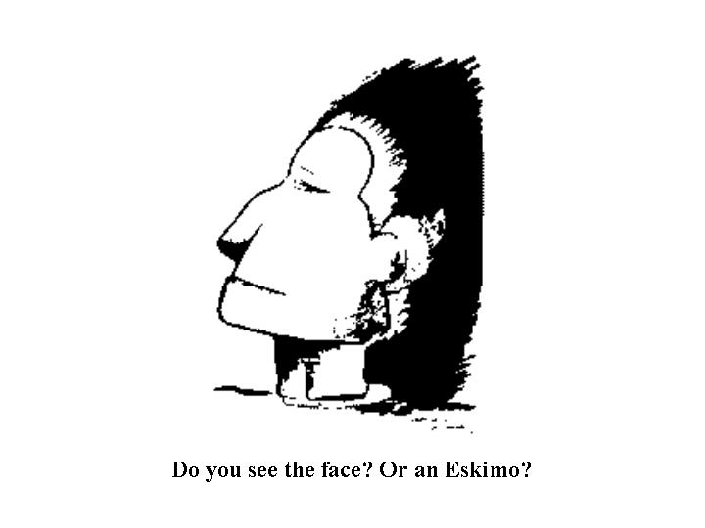

Slide 101
Over to you…
Part 3 – Cultural values and dimensions, some theorists –
to be finished by 26th April
Read the short texts on the following subjects and complete the corresponding quizzes/charts :
Universalist – particularist
Collectivist – individualist
Time capsule – see separate instructions on the forum
Which of the Trompenaars or Hofstede dimensions do you think might be different between your country and France ? How do you think this might manifest itself in daily life ?
Post your time capsules and any thoughts on the forum.

Slide 102
Culture Shock !
Everyone goes through it
More or less stressful
Over a more or less long period
Can’t avoid it but can understand and minimize it
Different stages
The honeymoon period
The hostility (conflict) period
The humour (recovery) period
The « at home » period
The re-entry period

Slide 103
The Honeymoon Period
Characteristics
Busy getting organised
Observing and getting familiar
Meeting useful and friendly people
First social contacts
Seeing and doing new things
Feeling of excitement, adventure and optimism
Proud you’re making yourself understood
What people say…
Isn’t this exciting !
Aren’t they interesting !
I can’t wait to tell x about this !
Everything here is so …

Slide 104
The Hostility (conflict) Period
What people say…
We would never do THAT in MY country !
Why can’t they just…
These people are so…
Only x more weeks/months before I go home
Characteristics
You want more personal relationships with host culture
You find you don’t have time to make friends
You feel isolated and out of place
You may feel tired, sick, depressed, angry or frustrated
Your high expectations are not being met
You blame the host culture for your problems
You spend lots of time with members of your home culture complaining about the host culture
You have problems with the subtelties of the language

Slide 105
The Humour (recovery) stage
What people say…
Well, why shouldn’t they do that ?
Actually, I’m beginning to quite like this.
They’re quite cute, really !
Characteristics
You choose to become an « explorer » of the new culture.
You accept the challenge of self-reflection.
You assume responsibility for your own cultural adjustment.
Your language skills improve noticeably.
You begin to understand why members of the host culture do what they do.

Slide 106
The « At Home » Period
What people say…
We do that too, only in a different way !
You don’t understand them like I do !
Characteristics
You have finally made friends.
You feel part of the community.
You develop a greater tolerance of what is strange and new in the host culture.
You become a mediator between the two cultures.

Slide 107
Re-entry
Don’t forget…
Going back can be more difficult than coming !
Characteristics
Happy
Neutral
Sad
Give yourself time to re-adjust.
Remember that it’s difficult for people who haven’t experienced the same thing to understand what you’re talking about.

Slide 108
Possible Stress Factors
Cultural differences
Ethnocentrism
Language
Cultural immersion
Cultural isolation
Previous/other intercultural experience
Expectations
Visibilty/invisibilty
Status/power and control

Slide 109
Possible Stress Factors
Any time you go into a different culture there will be a certain shock. Some of the reasons for this shock were shown on the previous page.
It is possible to analyse which of these factors will be the most stresful for you and to find strategies to cope with them.
Not all of the factors will always cause stress.

Slide 110
Possible Stress Factors
Cultural differences – the greater the cultural differences between your culture and the new culture the greater the possible level of stress.
Ethnocentrism – the more ethnocentric your culture and the more ethnocentric the new culture the greater the possible level of stress.
Language – the less of the new culture’s language you speak or the degree of difference between your language and the new language the greater the possible level of stress.
Cultural immersion – the more totally immersed you are in the culture (eg. Living with a host family) the greater the possible level of stress.

Slide 111
Possible Stress Factors
Cultural isolation – the more isolated you are from your own culture the greater the possible level of stress.
Previous/other intercultural experience – the less experience you have the greater the possible level of stress.
Expectations – the higher your expectations are the greater the possible level of stress.
Visibility/invisibilty – the more visible you are (the more different you are physically) to the people of the new culture the greater the possible level of stress.

Slide 112
Possible Stress Factors
Status/power and control – you may experience a loss of status, power or control when you move into a new culture. The greater this loss the greater the possible level of stress.
Before you leave analyse each of these factors to see which you think may potentially cause problems. Think before you leave about ways in which you could try to reduce the potential stress How will you cope ?

Slide 113
Last thought for the moment...
The Challenge!
How to describe?
How to tell?
How to look?
How to go beyond …
To go behind
Not to stop at what we are given to see, not to see only what we already knew we would see?
How to comprehend what is not shown to us, what has not been photographed, archived, restored, displayed?
Georges Pérec and Robert Bober

Slide 114
Over to you…
Part 4 – Culture shock, getting ready to leave –
to be finished by 10th May
Think about the possible stress factors – which are the most important for you ? How do you plan to cope with them.
Think about an important change in your life (moving house, changing school, leaving home). How did you feel just before and after, 1 month after, 6 months after, 1 year after ? Draw a graph to represent this with « level of satisfaction » on the left and « time period » on the bottom. What does it look like ?
Post your thoughts on the forum.

Slide 115
Works Cited
Figuring Foreigners Out: A Practical Guide, Craig Storti, Intercultural Press, 1999
Riding the Waves of Culture: Understanding Cultural Diversity in Business, Fons Trompenaars and Charles Hampden-Turner (Editor), Nicholas Brealey Publishing, 1994
Cultures and Organisations Software of the Mind , Geert Hofstede, McGraw-Hill, 1999
The Hidden Dimension, Edward T. Hall, Doubleday, 1965

